Slide 1
major global financial crises
- Created by Lance

Slide 2
outline
01.
Asian Financial Crisis in 1997.
02.
Black Monday in 1998.
03.
Bursting of the Dot-Com Bubble in 2000.
04.
The Great Recession in 2008.
05.
Black Monday in 2011.
06.
Covid-19 in 2020

Slide 3
The Asian Financial Crisis in 1997
01

Slide 4
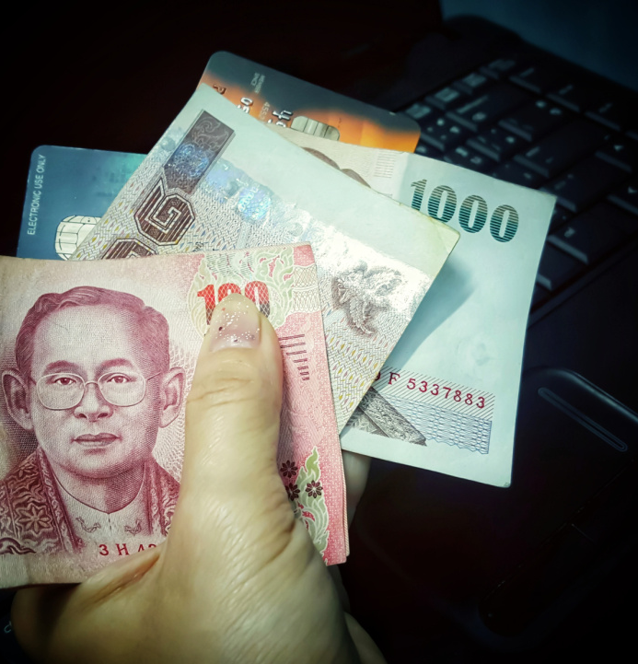


Causes:
01
02
03
Currency Devaluation
Capital Flows
Debt issue
In July 1997, Thailand abandoned its fixed exchange rate system.
Before the Crisis, several Asian countries experienced short-term capital flows.
Many asian banks and corporate burdened with high levels of debts.

Slide 5
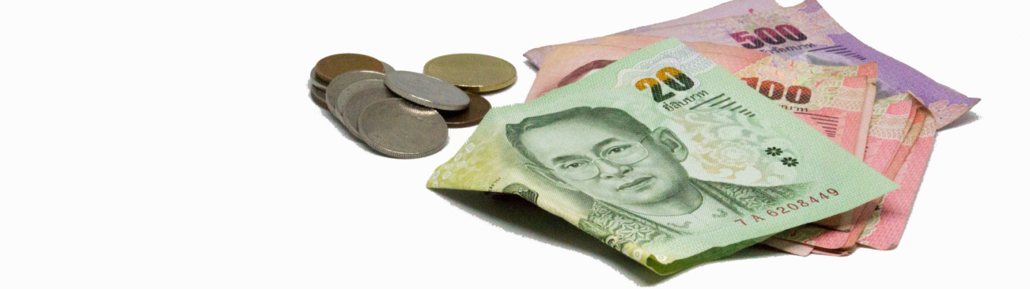
Impacts of Devaluation of Thai Baht
Economic Turmoil
Rising Risks
Ripple Effects
The devaluation of the Thai baht led to skyrocketing domestic prices in Thailand, decreased purchasing power, and social unrest
Currency devaluation raised investment costs and exchange rate risks for multinationals in Thailand
The baht’s devaluation triggered currency devaluations across Asia, worsening the regional economic crisis

Slide 6
Speculative Attacks and Political Instability
01
02
03
Thai
Korean
Indonesia
In 1997, speculative attacks on the baht led to its devaluation and the Asian Financial Crisis
Korea faced severe pressure, accepted IMF aid, and saw increased political instability.
The crisis devalued the rupiah, causing social unrest and the fall of Suharto’s regime.
Slowdown in Asia affected U.S. trade and investment.

Slide 7
Black Monday in 1998
02

Slide 8
Dow Jones Industrial Average plummeted
01
02
03
Russian Debt Default
LTCM Crisis
Loss Confidence
In 1998, Russia’s debt freeze sparked global panic and a sharp drop in the Dow Jones Index.
LTCM’s near-bankruptcy triggered a global financial chain reaction and worsened stock market turmoil
Fears of an economic downturn led to a stock sell-off and a Dow Jones crash on Black Monday.

Slide 9
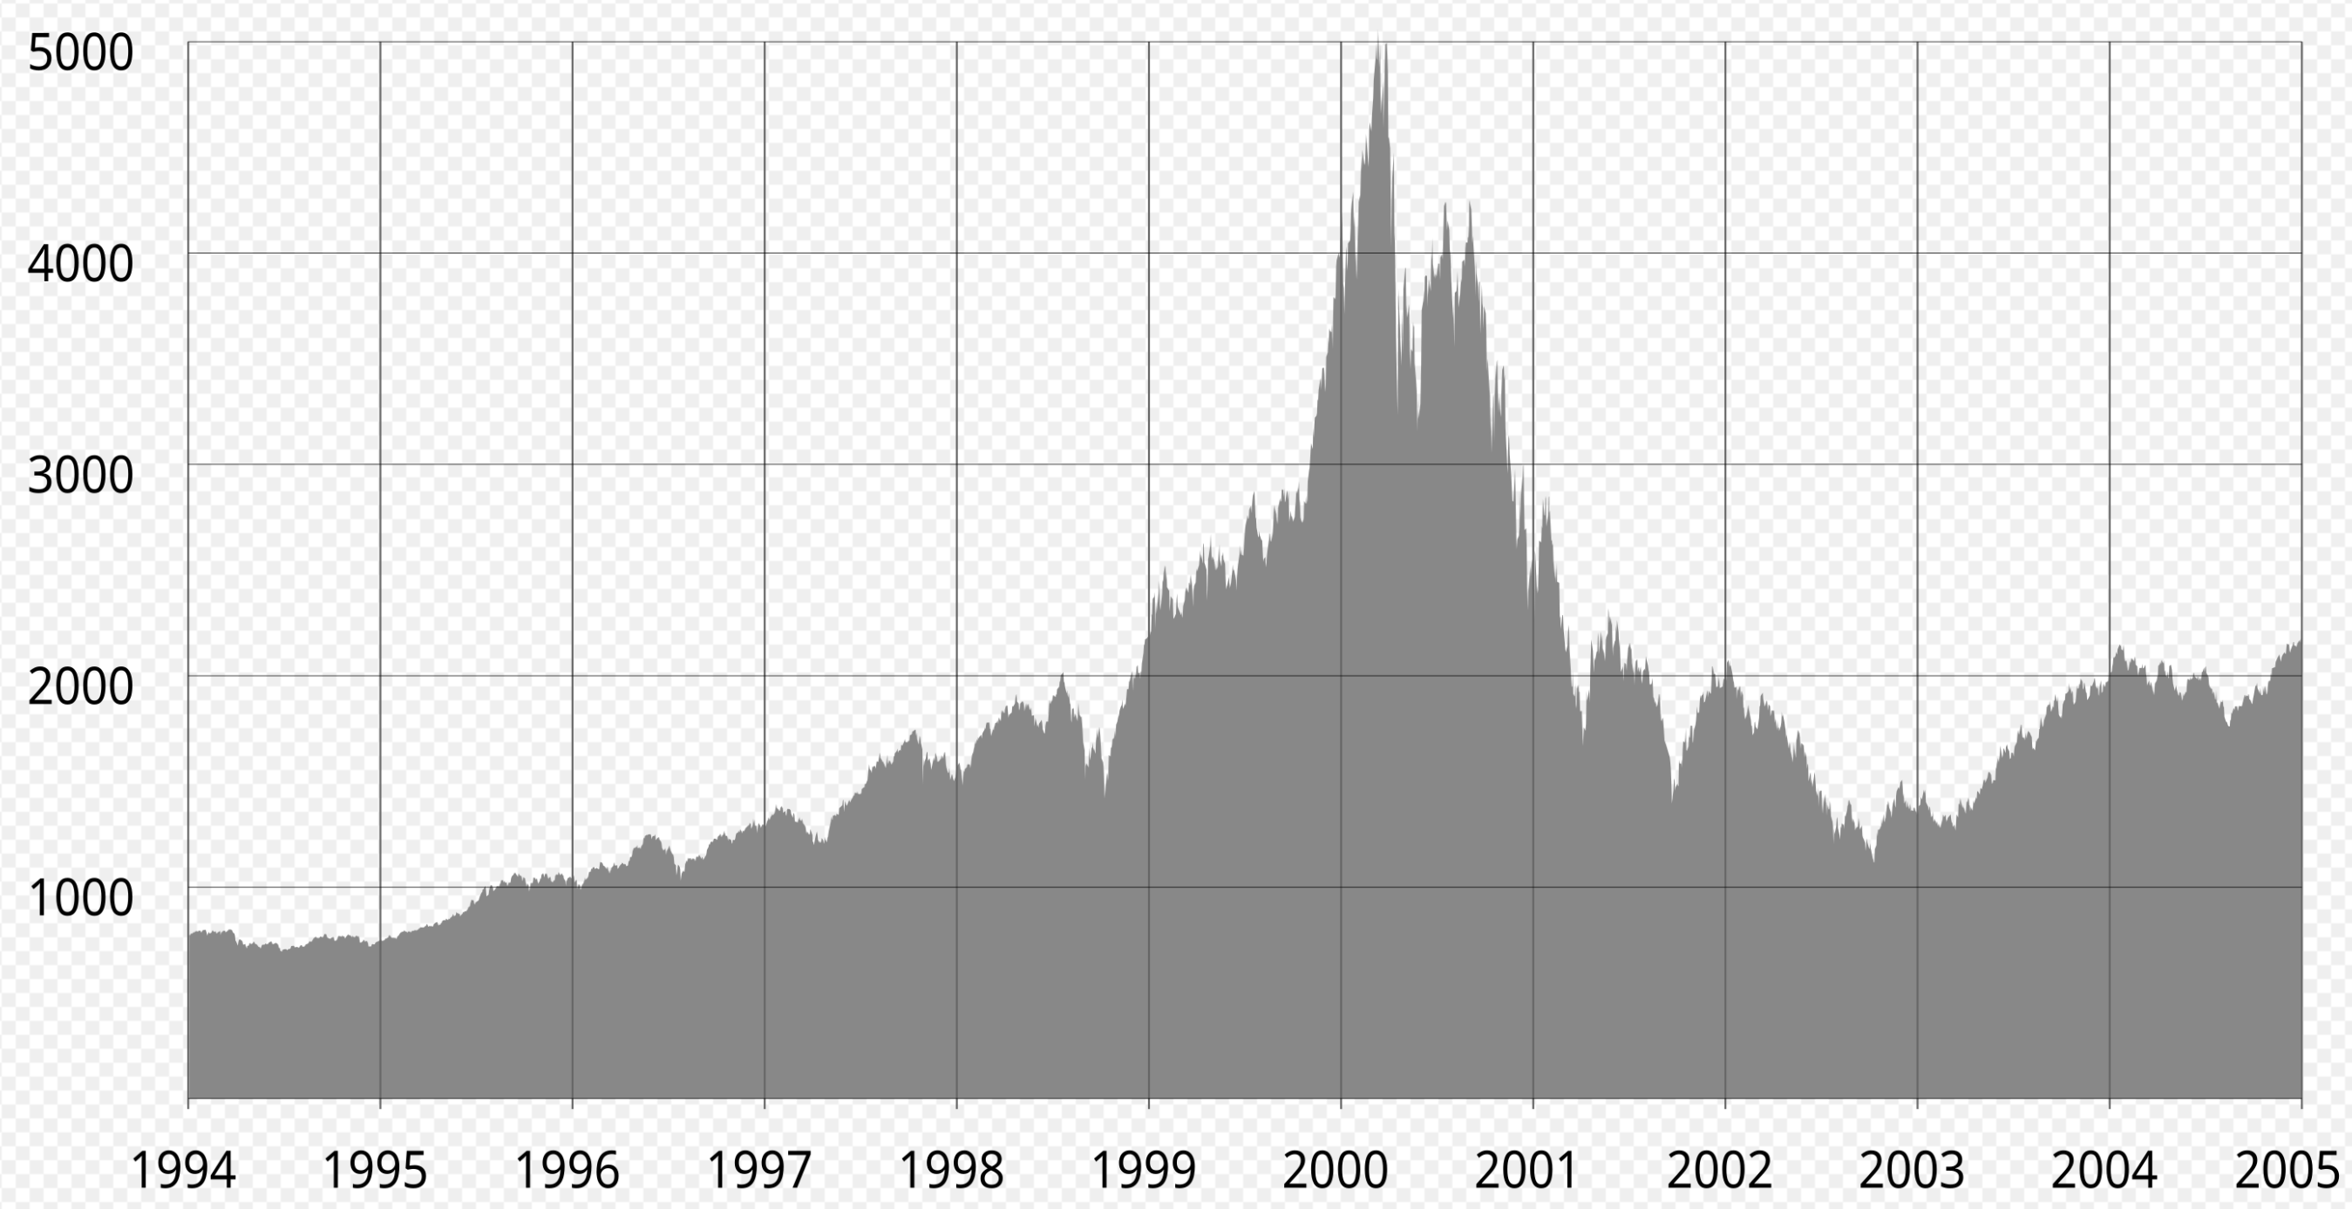
Dot-Com Bubble in 2000
03

Slide 10



Bubble Burst
IR Decline
Aftermath
Bankruptcies
During the dot-com crash, numerous online shopping and communication companies, including Pets.com and Worldcom, failed and shut down
Taxpayer Relief Act of 1997 lowering the top marginal capital gains tax and increasing speculative investment
There are about 48% dot-com companies went though the crisis, albeit at lower valuations.

Slide 11
The Great Rcession in 2008
04

Slide 12
Bankcruptcy of Lehman Brother
01
Risky MBS(Mortgage-Backed Security)
A financial production backed up by a pool of mortgages that faced to the borrowers with poor credits
02
CDS(Credit Default Swaps)
A tool to manage financial risk became a source of significant risk.
03
Rising Defaults
As house price dropped, many defaults came up, leading to a great loss for MBS investors.

Slide 13
Black Monday in 2011
05

Slide 14



U.S. credit rating downgrade
On August 5, 2011, S&P downgraded the U.S. credit rating, causing market turmoil
The U.S. credit rating downgrade impacted global economies, including Europe and Asia.
First time Rating Downgrade
Global Impacts
Loss of Market Confidence
After the downgrade, investor confidence in the U.S. fell, causing major market fluctuations.

Slide 15
Covid-19 in 2020
06

Slide 16


Worries - global recession
01
Supply chain disruption
Pandemic lockdowns disrupted global supply chains, causing shortages and production delays
02
Collapse of the tourism industry
Travel restrictions and reduced travel nearly collapsed the tourism industry, impacting the economy.
03
Increased market volatility
Pandemic uncertainty caused severe market fluctuations, eroded investor confidence, and spread panic.

Slide 17
Thanks

